Slide 1

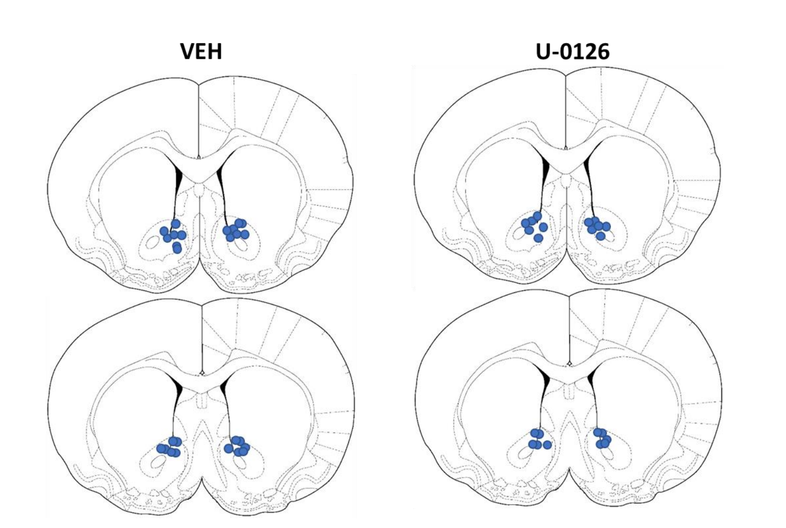
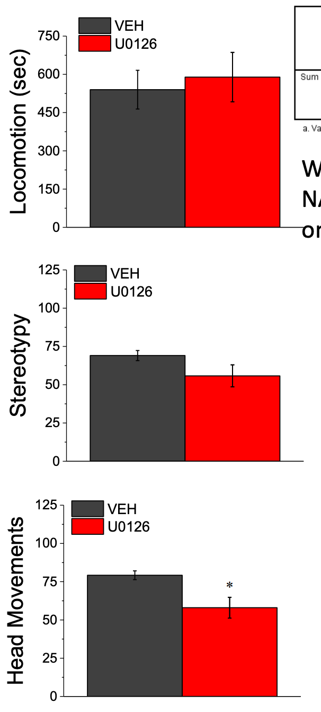
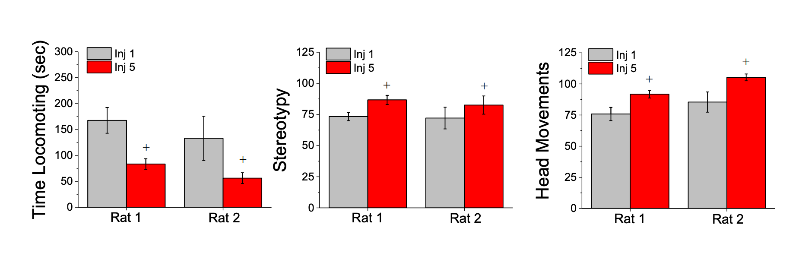

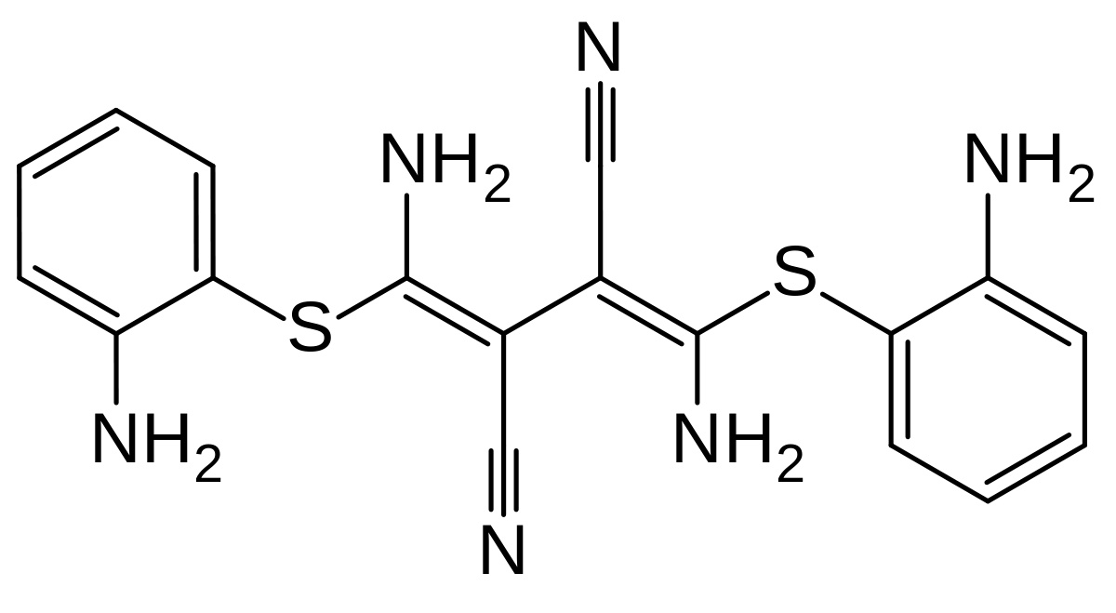
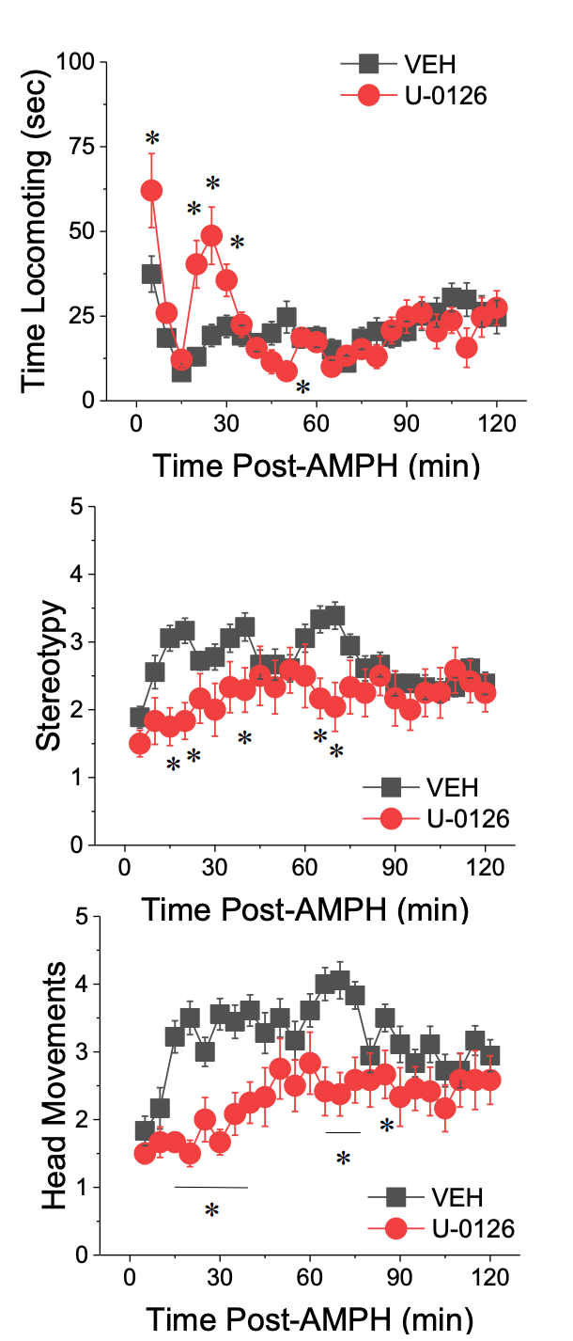

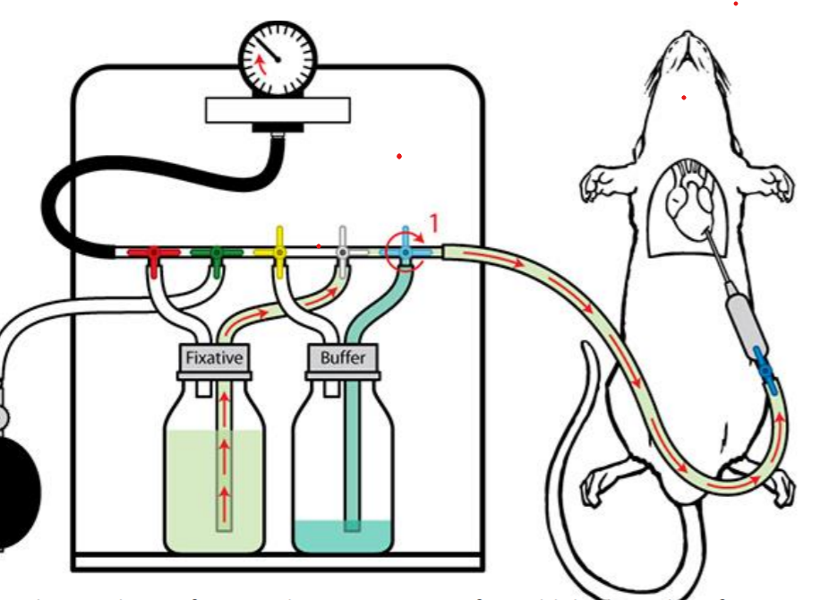
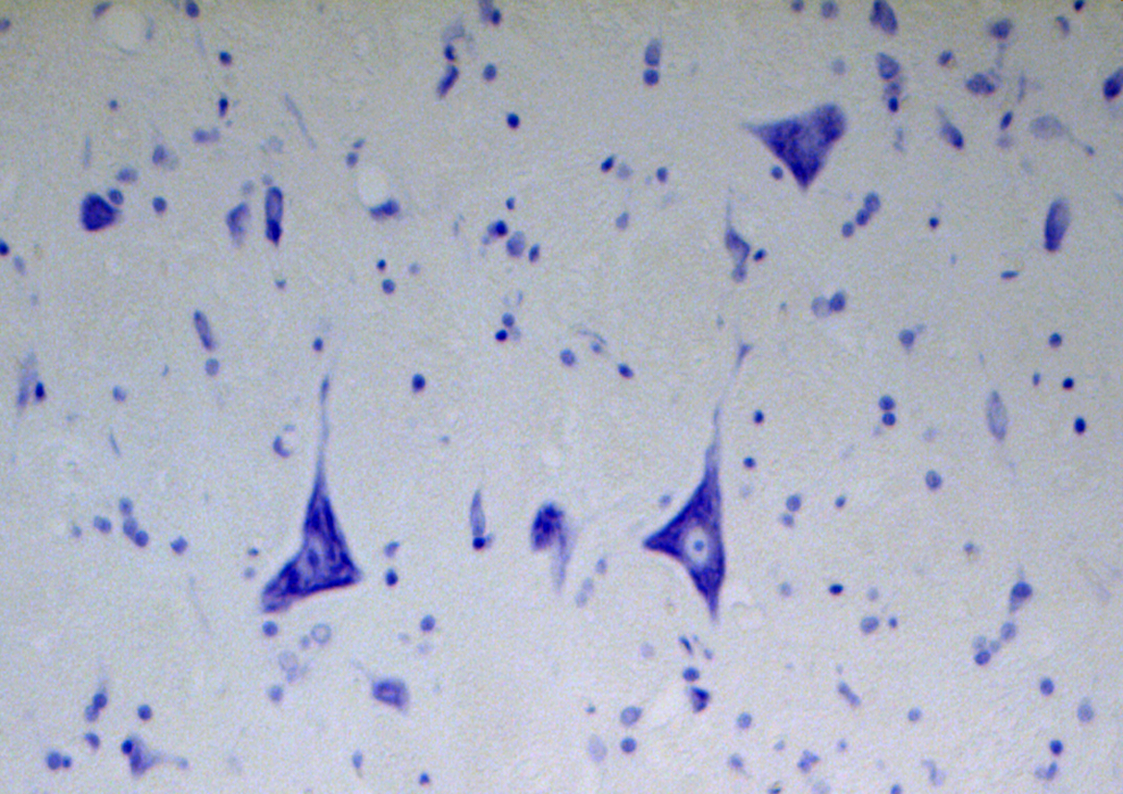
AMPH-Induced Behavioral Sensitization Mitigated by ERK Inhibition
Nemr Nahle
Department of Psychological & Brain Sciences, University of California, Santa Barbara, CA
Introduction
Histology
Figure 3
A
Using an independent samples T-test we did not see a significant difference in between subjects effects on total locomotion between our vehicle and UO126 group [Rat effect: t(28)=0.40, p=0.93] (3A). We were able to see significant differences in both total stereotypy [Rat effect: t(28)=1.87, p=0.009](3B) and total head movement [Rat effect: t(28)=3.23, p=0.008](3C)
‣ Amphetamines (AMPH) are sympathomimetic drugs which have been known to lead to certain behavioral sensitization effects with repeated use [1]
‣ Behavioral sensitization is seen as the heightening of a certain effect of a drug through repeated administration. This is opposed to drug tolerance in which one would expect to see lessened drug effects following continued exposure to a drug. [1]
‣ Studying the effects of AMPH-induced sensitization can be important to understanding the underlying pathology of Schizophrenia exacerbated by AMPH-use as well as understanding drug-seeking behavior
‣ Extracellular signal-related kinase (ERK) is a signalling kinase involved in various different processes leading to gene transcription through its phosphorylation and activation of other kinases. ERK inhibition in rats not already sensitized to amphetamine show reduced sensitization, but those not given ERK inhibitor post sensitization do not show any decrease in sensitization. This reveals implications for ERK’s role in mediating AMPH-induced behavioral sensitization and general drug-reward seeking behavior [3]
‣ The nucleus accumbens (NAcc) The nucleus accumbens in the ventral striatum is innervated by dopamine neurons from the ventral tegmental area. This pathway is highly implicated in addiction and various behavioral disorders that are characterized by motivational deficits. The nucleus accumbens is part of a motivation-emotion interface which guides general exploratory reward-directed type behaviors. [4]
‣ Since the repeated administration of amphetamines are required for the increase in ERK expression in the NAC for behavioral sensitized behaviors [2], we hypothesize that the inhibition of ERK signaling using UO126 should reduce sensitized responses.
Bilateral intracranial injections of vehicle and UO126 into medial dorsal region of NAcc. Placements were comparable between VEH and UO126 injections.
B
C
Figure 1
Discussion
A
B
C
‣ Our goal for this study was to investigate the effects of ERK inhibition on behavioral sensitization to subjects exposed to repeated AMPH treatments. We hypothesized that our injection of UO126 into the nucleus accumbens would have some significant effect on AMPH-induced behavioral sensitization.
‣ Both of our rats exhibited an increase in stereotypy and general head movements and a decline in total horizontal locomotion. The decline in locomotion would point to drug tolerance, but the increase in our stereotypy and head movements after repeated AMPH treatments reveal a sensitization effect.
‣ Our UO126 injection to inhibit ERK in the nucleus accumbens didn’t create a significant alteration in total locomotion time, but did show significant declines in total stereotypy and head movements. Effects of ERK inhibition were most seen in the first hour after UO126 injection in regards to the reductions in stereotypy and head movements. Our time-course also shows an increase in first hour locomotion, but this effect is not seen when examining the total time of locomotion.
‣ From this we can interpret that the inhibition of ERK in the nucleus accumbens reversed the effect of AMPH-induced behavioral sensitization. The increase in locomotor activity and decrease of stereotyped behavior suggest that the decline in the stereotyped behaviors may have allowed for the increase in locomotor activity. It may be that locomotor activity is suppressed in rats normally treated with AMPH by the stereotyped behaviors and the inhibition of ERK allows for locomotion to be more strongly expressed at least within the first hour post AMPH injection.
‣ Valjent et al (2006) demonstrated that blocking ERK doesn’t alter expression of locomotor sensitization which is somewhat consistent in our findings on total locomotor activity. Through our time-course we were able to tease out an effect when looking specifically at the first hour. One major difference between our studies was the way in which we administered the drugs. They administered their ERK inhibitor peripherally which may point to ERK expressing itself in other areas outside of the brain outside of the NAcc and used the drug SL237 as opposed to our use of UO126 which may have different affinities for ERK which affect their strength in inhibition.[4]
‣ Our findings for locomotion were also opposite to those found in Kim et al (2011) who examined cocaine-induced sensitized behavior. They only examined locomotion and observed a total reduction. While we used an ERK inhibitor to block AMPH induced behavioral sensitization we saw an effect on stereotypy which then allowed for the subsequent expression of horizontal locomotion. [5]
‣ Our study could be improved by examining how female rats as well as other animals would be affected, the effect of the injections themselves on behavior, and following up weeks after sensitization with another AMPH-treatment and test to see if rats show consistent sensitization. Experimenting with different ERK inhibiting drugs as well as different doses of our UO126 with a more gradual doses along a dose response curve as opposed to our single dose may also elucidate more of the specific effects of ERK inhibition.
‣ These findings may be beneficial in understanding how to lower stereotypic behaviors in those struggling with addiction for therapeutic benefit. Gomez et al (2020) examined the involvement of striatal Zinc involved with Cocaine addiction.[6] This in conjunction with ERK inhibition may provide promising insights into treating and understanding addiction. Agoglia et al (2015) found an increase in ERK signaling in brain regions linked to drug-seeking regulation in response to alcohol consumption and Besheer et al (2012) revealed the effects of ERK signaling for the discriminative stimulus effects of alcohol (examining ERK function within the amygdala as opposed to the nucleus accumbens) which may also be used to understand drug reward seeking behavior. [7][8]. Vinci et al (2010) found that the conversion of ethanol to aldehyde saw an activation of ERK within the nucleus accumbens and amygdala which along with our study helps to examine the role of ERK specifically in the accumbens. [9]
‣ Future research may be well served in incorporating the findings from this research and perhaps examining the effects of different doses, different drugs, and different brain regions for ERK inhibition. Building upon the body of ERK research may provide fruitful avenues for understanding the drug-reward motivated seeking behavior as well as uncovering new ideas for therapeutic treatment.
We observed a significant lower total time spent locomoting with injection of 4mg/kg AMPH on Injection 5 compared to Injection 1 [Injection Effect: F(1, 28)=20.37,p<0.001](1A). We did not see a significant difference in effect in the size of changed locomotor response to AMPH[Between Rat effect: F(1,28)=0.20, p<0.66](1A) or on the size of the change in locomotion in response to repeated AMPH treatment [Rat X Injection: F(1,28)=10.17, p=0.658].(1A)
For stereotypy and head movements we saw a significant increase in scores on Injection 5 compared to Injection 1 [Injection Effect: F(1, 28)=3.3, p<0.001](1B) and [Injection Effect: F(1, 27)=5.161, p<0.001](1C). We did not see differences between each rat in response strength of stereotypy [Rat effect: F(1,27)=13.16, p=0.001](1B) but we did observe a significant difference to the amount of sensitization undergone in response to repeated AMPH exposure [Rat X Injection: F(1,28)=0.16, p<0.001](1B). A significant difference in head movements between rats was seen with an increase in Injection 5 compared to 1. [Rat effect: F(1,27)=13.16, p=0.01](1C) as well as the strength head movement sensitization from AMPH treatment [Rat X Injection: F(1,28)=2.8, p<0.001].(1C)
Methods
Animals
‣ Male Sprague-Dawley rats weighing 225-250g at start of experiment housed in polyethylene cages (35x30x16cm). Food and water available ad libitum. Testing done during light part of day starting at 0900 hours. Animals were acclimated for 2 weeks to colony room. Approval from Institutional Animal Care and Use Committee of the University of California at Santa Barbara consistent with recent guidelines of the NIH Guide for Care and Use of Laboratory animals (9th Edition, National Academy Press, 2014)
Drugs
‣ Amphetamine (Sigma-Aldrich, St. Louis MO) 4mg/kg introduced systemically.
One week interval between treatments with 3 treatments total.
ERK1/2 Inhibitor U-0126 (LC Laboratories) 100nM introduced intracranially
One treatment after Amphetamine treatments.
Apparatus
‣ Locomotor and stereotype activity monitored (in a non-colony room?) containing two polyethylene cages (35x30x16cm) viewed through camera.
Behavioral Scoring
‣ Used two behavioral rating scales for monitoring stereotyped behavior (GS) (Creese and Iversen 1972) and repetitive head movements (RHM) (Ujike et al. 1992). Rats were monitored for the first 15 seconds of every 5 minute interval for 2 hours. Scored on injection 1 and 5 of repeated amphetamine treatment, as well as on test for behavioral sensitization. Horizontal locomotion timed with stopwatch throughout the entirety of 2 hour period.
Surgery
‣ Under isoflurane anesthesia (4% for induction; 1.5-2.5% for maintenance), microinjector guide cannulae (26 gauge, 20mm, Plastics One, Roanoke VA) implanted bilaterally 2mm over NAC under coordinates (AP: +1.5 mm; ML: +/- 1.0 mm; DV: -4.6 mm;). Guide cannulae fixed to skull with 4 screws (Screws from Specialty Tool and Bolt (Goleta, CA, USA)). Analgesia administered preoperatively and for all 4 post-operative days. Behavioral testing occurred a minimum of 7 days later.
Tissue Collection/Histology
‣ Rats euthanized post testing using Euthasol given intraperitoneally prior to tissue extraction. Brains removed and stored in 60ml solution of 2% paraformaldehyde and saline which was then changed to a buffer solution. Brains sectioned along the coronal plane on vibratome at level of NAC (100 µm; AP +2.2 to 1.0mm, relative to Bregma) according to atlas of Paxinos and Watson (2000). We used Nissl staining to stain sections with cresyl violet for histological examinations.
Figure 2
A
Using ANOVA across all 3 variables we were able to find significant differences in time spent locomoting post-AMPH between our vehicle and UO126 [Injection Effect: F(1, 28)=20.37, p<0.001](2A). We did not see significant group differences for overall locomotive times [Rat effect: F(1, 28)=.201, p=.658](2A), but we did see significant differences in the time course of locomotion over the entire 2 hour period [Rat x Time interaction: F(1, 28). For general stereotypy we were able to see significant differences in total time seen exhibiting stereotypic behavior between our vehicle and UO126 groups [Injection effect: F(1, 28)=3.29, p<0.001](2B). We did not see significant differences between groups for overall stereotypy [Rat effect: F(1, 28)=4.09, p=0.053](2B). We did see a significant difference in the time course for stereotypy for the rats over the entire trial period [Rat x Time interaction: F(1, 28)=2.87, p<0.001]. For head movements, we saw an significant overall change [Injection Effect: F(1, 27)=5.16, p<0.001](2C) as well as a significant group difference [Rat effect: F(1, 27)=12.16, p=0.001](2C).
B
References
Creese I, Iversen SD. Blockage of amphetamine induced motor stimulation and stereotypy in the adult rat following neonatal treatment with 6-hydroxydopamine. Brain Res. 1973 Jun 15;55(2):369-82. doi: 10.1016/0006-8993(73)90302-8. PMID: 4145950. [1]
Kim, S., Shin, J., Yoon, H. S., & Kim, J. (2011). Blockade of ERK Phosphorylation in the Nucleus Accumbens Inhibits the Expression of Cocaine-induced Behavioral Sensitization in Rats. The Korean Journal of Physiology and Pharmacology, 15(6), 389. doi:10.4196/kjpp.2011.15.6.389 [2]
Lominac KD, Quadir SG, Barrett HM, McKenna CL, Schwartz LM, Ruiz PN, Wroten MG, Campbell RR, Miller BW, Holloway JJ, Travis KO, Rajasekar G, Maliniak D, Thompson AB, Urman LE, Kippin TE, Phillips TJ, Szumlinski KK. Prefrontal glutamate correlates of methamphetamine sensitization and preference. Eur J Neurosci. 2016 Mar;43(5):689-702. doi: 10.1111/ejn.13159. Epub 2016 Feb 22. PMID: 26742098; PMCID: PMC4783259. [3]
Valjent, E., Corvol, JC., Trzaskos, J.M. et al. Role of the ERK pathway in psychostimulant-induced locomotor sensitization. BMC Neurosci 7, 20 (2006). https://doi.org/10.1186/1471-2202-7-20 [4]
Kim, S., Shin, J. K., Yoon, H. S., & Kim, J. H. (2011). Blockade of ERK Phosphorylation in the Nucleus Accumbens Inhibits the Expression of Cocaine-induced Behavioral Sensitization in Rats. The Korean journal of physiology & pharmacology : official journal of the Korean Physiological Society and the Korean Society of Pharmacology, 15(6), 389–395. https://doi.org/10.4196/kjpp.2011.15.6.389 [5]
Juan L. Gomez, Jordi Bonaventura, Jacqueline Keighron, Kelsey M. Wright, Dondre L. Marable, Lionel A. Rodriguez, Sherry Lam, Meghan L. Carlton, Randall J. Ellis, Chloe Jordan, Guo-hua Bi, Marco Pignatelli, Michael J. Bannon, Zheng-Xiong Xi, Gianluigi Tanda, Michael Michaelides doi: https://doi.org/10.1101/2020.08.29.273482 [6]
Agoglia, A. E., Sharko, A. C., Psilos, K. E., Holstein, S. E., Reid, G. T., & Hodge, C. W. (2015). Alcohol alters the activation of ERK1/2, a functional regulator of binge alcohol drinking in adult C57BL/6J mice. Alcoholism: Clinical and Experimental Research, 39(3), 463-475. doi:http://dx.doi.org.proxy.library.ucsb.edu:2048/10.1111/acer.12645 [7]
Besheer, J., Fisher, K. R., Cannady, R., Grondin, J. J. M., & Hodge, C. W. (2012). Intra-amygdala inhibition of ERK 0RW1S34RfeSDcfkexd09rT41/21RW1S34RfeSDcfkexd09rT4 potentiates the discriminative stimulus effects of alcohol. Behavioural Brain Research, 228(2), 398-405. doi:http://dx.doi.org.proxy.library.ucsb.edu:2048/10.1016/j.bbr.2011.12.023 [8]
Vinci, S., Ibba, F., Longoni, R., Spina, L., Spiga, S., & Acquas, E. (2010). Acetaldehyde elicits ERK phosphorylation in the rat nucleus accumbens and extended amygdala. Synapse, 64(12), 916-927. doi:http://dx.doi.org.proxy.library.ucsb.edu:2048/10.1002/syn.20811 [9]
Schroeder, J. P., Spanos, M., Stevenson, J. R., Besheer, J., Salling, M., & Hodge, C. W. (2008). Cue-induced reinstatement of alcohol-seeking behavior is associated with increased ERK 0RW1S34RfeSDcfkexd09rT41/21RW1S34RfeSDcfkexd09rT4 phosphorylation in specific limbic brain regions: Blockade by the mGluR5 antagonist MPEP. Neuropharmacology, 55(4), 546-554. doi:http://dx.doi.org.proxy.library.ucsb.edu:2048/10.1016/j.neuropharm.2008.06.057 [10]
C
Acknowledgements
Special thanks to Dr. Karen Szumlinski and Leo Jimenez Chavez

